Slide 1

Microsoft Azure Stack Disconnected Scenarios
Special Considerations

Slide 2
Agenda
Connectedness
Adjacent systems for identity, monitoring, and management
Deployment of a disconnected Azure Stack
Disconnected registration
Disconnected certificate use
Disconnected identity with ADFS
Disconnected time sync
Disconnected marketplace syndication
Disconnected licensing, billing, and consumption reporting
Disconnected backup
Disconnected support scenarios

Slide 3

Why run disconnected?
Security/Network - You have security or network topology restrictions that require you to deploy Azure Stack in an environment that is not connected to the Internet
Privacy - You want to block data (including usage data) from being sent to Azure
Private Cloud - You want to use Azure Stack purely as a private cloud solution, with hybrid scenarios not a priority
It is still possible to expand a disconnected Azure Stack to accommodate hybrid scenarios, but there will not be a shared Azure AD identity between Azure Stack and Azure

Slide 4
Connectedness and Identity
Two inter-related decisions

Slide 5
Connectedness affects the identity decision
 | Connected | Disconnected
Azure Active Directory | Operator and user identity comes from AAD Azure Stack must be always connected Multi-tenancy possible (can use multiple tenant AAD instances) | N/A
AD with AD FS | Operator and user identity comes from local AD, federated to Azure Stack with AD FS Azure Stack could be sometimes-connected Single directory/tenant only | Operator and user identity comes from local AD, federated to Azure Stack with AD FS Single directory/tenant only
Consumption or Capacity Billing
Capacity Billing Only

Slide 6
Disconnected – Always or Sometimes?
A ‘connected’ Azure Stack does not need to be always connected

Slide 7

How often does Azure Stack need to connect?
The licensing terms for a ‘connected’ Azure Stack state that it must connect for billing purposes at least once every 30 days

Slide 8



Sometimes-Connected Scenarios
Cruise ship
Mobile unit (exploration, military, disaster relief)
This Photo by Unknown Author is licensed under CC BY-ND

Slide 9
Adjacent Systems for Identity, Monitoring, and Management
Connecting to other local ‘stuff’

Slide 10

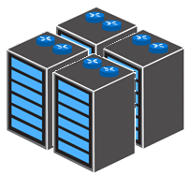
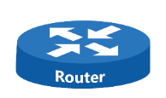

Minimal ‘Normal’ Deployment
A border router connected to the Azure Stack switches provides external connectivity
Certificates must be provided to Azure Stack. Could use AD CS.
During setup, you choose an Active Directory as the identity source
Border Router
Federation Services
Azure Stack requires additional external services to operate
It needs AD FS to federate to the internal Azure Stack AD FS
Someone is going to use the workloads running in Azure Stack
Azure Stack
Input Devices
There may be input or IoT devices
Users
This is a small-scale Azure Stack topology

Slide 11


…With In-Rack Infrastructure
Border Router
Normal customer network routing
‘Jump’ servers with AD DS, AD FS, AD CS, DNS, NTP
Firewall devices for better isolation
All equipment mounted in the same rack
Azure Stack
Azure Stack with extras in-rack

Slide 12
Adjacent Systems
Backing up workloads to an external server will likely be important
CRL, DNS, Time
With a shared folder for Azure Stack backup
Manage VMs and adjacent infrastructure
This could run as VMs inside Azure Stack
Border Router
Federation Services
Consume events, alerts, and performance information.
Azure Stack
Input Devices
Users

Slide 13
‘Mobile’ Azure Stack – No Border Routers
Backup Share
Create additional “CloudAdmin” user:
#Connect to privileged endpoint
$cred = Get-Credential
Enter-PSSession -ComputerName <IP_address_of_ERCS> -ConfigurationName PrivilegedEndpoint Credential $cred
#Create additional CloudAdmin User Accounts $NewPW=read-host -assecurestring
New-CloudAdminUser -UserName "CloudUser" -Password $NewPW
BMC Switch Ports 41-44
Input Devices
With only the internal AD, and no external identity, you must use the interal CloudAdmin account or a clone for access to operator and user portal/endpoints. This scenario is for very low touch solutions.
Azure Stack

Slide 14
What breaks if you are disconnected?
Some features do not work the same when disconnected

Slide 15
Impacts of being disconnected (1)
Feature | Impact in Disconnected mode
Multi-tenancy | Unavailable - Using AD FS for identity means only a single (AD) directory can be connected
VM deployment with DSC extension to configure VM post deployment | Impaired - DSC extension looks to the Internet for the latest WMF.
VM deployment with Docker Extension to run Docker commands | Impaired – Docker will check the Internet for the latest version and this check will fail.
Documentation links in the Azure Stack Portal | Unavailable – Links such as Give Feedback, Help, Quickstart, etc. that use an Internet URL won’t work.
Alert remediation/mitigation that references an online remediation guide | Unavailable – Any alert remediation links that use an Internet URL won’t work.

Slide 16
Impacts of being disconnected (2)
Feature | Impact in Disconnected mode
Marketplace – The ability to select and add Gallery packages directly from the Azure Marketplace | Impaired – When you deploy Azure Stack in a disconnected mode (without any Internet connectivity), you can’t download marketplace items by using the Azure Stack portal. However, you can use the marketplace syndication tool to download the marketplace items to a machine that has internet connectivity and then transfer them to your Azure Stack environment.
Using Azure Active Directory federation accounts to manage an Azure Stack deployment | Unavailable – This feature requires connectivity to Azure. AD FS with a local Active Directory instance must be used instead.
Patch and Update | Impaired - Updates must be retrieved and imported using an offline import process.

Slide 17
Impacts of being disconnected (3)
Feature | Impact in Disconnected mode
App Services | Impaired - WebApps may require Internet access for updated content.
Command Line Interface (CLI) | Impaired – CLI has reduced functionality in terms of authentication and provisioning of Service principals.
Visual Studio – Cloud discovery | Impaired – Cloud Discovery will either discover different clouds or will not work at all.
Visual Studio – AD FS | Impaired – Only Visual Studio Enterprise supports AD FS.
Telemetry | Unavailable – Telemetry data for Azure Stack as well as any third-party gallery packages that depend on telemetry data.

Slide 18
Impacts of being disconnected (4)
Feature | Impact in Disconnected mode
Public PKI Certificates | Unavailable – Internet connectivity is required for Certificate Revocation List (CRL) and Online Certificate Status Protocol (OSCP) services in the context of HTTPS.
Key Vault | Impaired – A common use case for Key Vault is to have an application read secrets at runtime. For this the application needs a service principal in the directory. In Azure Active Directory, regular users (non-admins) are by default allowed to add service principals. In AD (using ADFS) they are not. This places a hurdle in the end-to-end experience because one must always go through a directory admin to add any application.
Logic Apps or other hybrid use cases | Unavailable – Logic Apps are a hybrid use case and cannot run when disconnected. No hybrid functionality is usable while disconnected.

Slide 19
App Service - Impacts of being disconnected
Feature | Impact in Disconnected mode
CI/CD Sources | Limited – Sources like GitHub/DropBox/OneDrive/BitBucket are limited to manual fetch if there is at least outbound connectivity, as there is no way for those services to trigger the webhooks that automatically initiate deployments. If there is no connectivity, then only CI/CD sources to Azure Stack will work.
Extensions | Limited – Extensions are a community driven feature with features produced by contributors; the feed which populates the gallery will not be reachable
EasyAuth | Unavailable – This feature enables easy configuration of Authentication with AAD, Microsoft Account, Google, Facebook, Twitter – without an Internet connection, these will fail.

Slide 20
App Service – More disconnected impacts
Feature | Impact in Disconnected mode
Azure Functions: Triggers and input bindings | Limited – Not all services are supported, given Azure Stack primarily only has Storage – therefore limited to Blobs, Tables, Queues, Timer, WebHook and HttpTriggers.
Applications that call online package managers during Kudu build | Limited – nuget, npm won’t be able to make these calls, as the worker roles will not be able to reach out to the Internet.
*Currently, installation of the App Service resource provider requires forms-based authentication during the installation. So if your customer AD FS has forms-based auth disabled (like if they use smartcard auth) installation will be blocked. Workaround to proceed without forms-based auth is in the pipeline.

Slide 21
Deployment of a Disconnected Azure Stack
What is different during deployment

Slide 22
Deployment considerations
There may be physical considerations for Azure Stack units that are mobile or where the disconnected environment is not a typical datacenter
Identity provider must be AD FS
You can provide the target AD FS federation metadata offline if the AD FS is not immediately accessible
Certificates must be provided from a PKI that will be accessible from the disconnected Azure Stack
You may not have a full BGP-enabled network, so static routing may be the only option for connectivity to adjacent systems

Slide 23
PowerShell on a Disconnected Azure Stack
How do you get the most recent cmdlets?

Slide 24
PowerShell Download Process
Install Azure Stack PowerShell to a connected machine
Enable additional storage features
Transport the PowerShell packages to your disconnected workstation
Confirm the installation of PowerShell
Get PowerShell from an online workstation and transport it to Azure Stack
Actions on Connected Workstation
Actions on Azure Stack

Slide 25
Disconnected Registration
An initial task to perform off-stack

Slide 26
Registration Process
Import PowerShell registration module on Azure Stack
Get registration token file
Take token to Internet-connected computer
Register with Azure
Get Azure activation key
Use the key to create activation resource in Azure Stack
This is a back and forth activity between Azure Stack and Azure
Actions on Connected Workstation
Actions on Azure Stack

Slide 27
Disconnected Resource Provider Installation
What’s different during deployment

Slide 28
Resource Provider Installation Process
Download a copy of the RP on an Internet-connected computer
Take a copy to a computer on the isolated Azure Stack network
Complete the deployment process
Get the RP from an Internet-connected workstation and copy/deploy to Azure Stack
Actions on Connected Workstation
Actions on Azure Stack

Slide 29
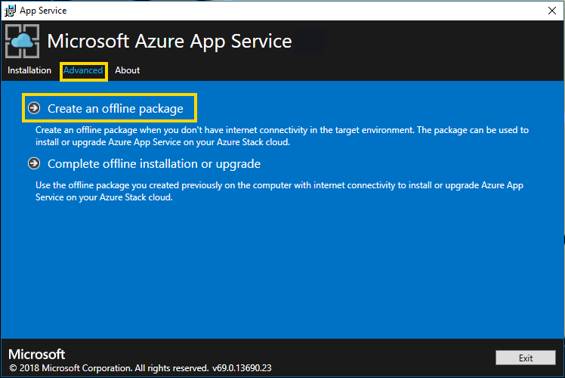
App Service RP offline installation
On a computer with Internet connectivity, you create the offline installer package

Slide 30
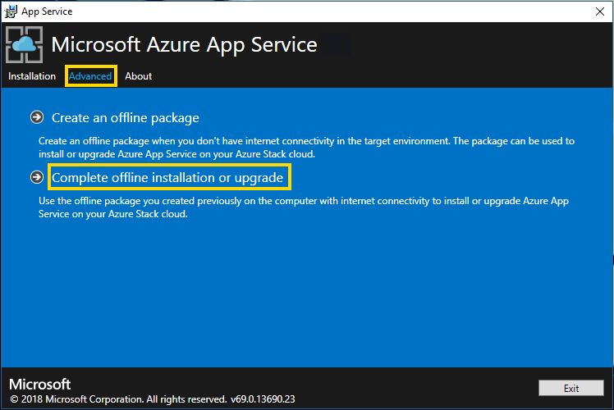
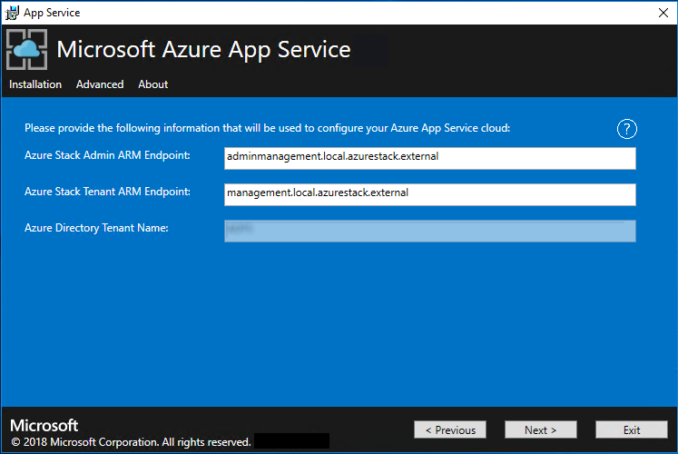
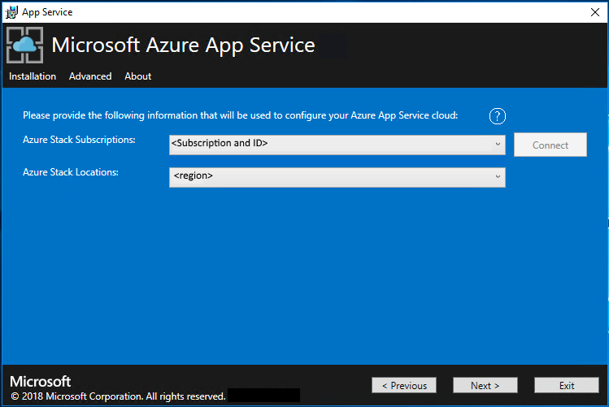
App Service RP offline installation
Complete the offline installation on Azure Stack
From a computer that can reach the Azure Stack Admin Azure Resource Management endpoint

Slide 31
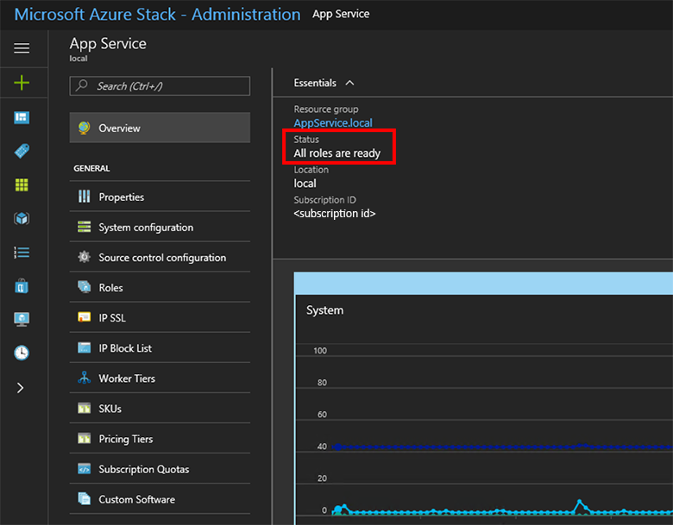
App Service RP offline installation
A successful installation will end with all App Service roles ready for use. You can observe this in the portal.

Slide 32
SQL/mySQL RP
Similar process to App Service RP offline installation
Download the RP installer files
Copy them into the disconnected Azure Stack environment (Win 10 or Server 2016 VM - a computer that can reach the Azure Stack Admin Azure Resource Management endpoint)
Make sure the Azure Stack PowerShell modules are installed and that the required server core VM image is available in the Marketplace
Place required X.509 certificate PFX file in the right path for installation
Run the installer
Verify the deployment in the Azure Stack admin/operator portal

Slide 33
Disconnected Certificate Use
PKI considerations

Slide 34
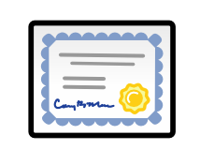
PKI considerations
Certificates must be issued from an internal Certification Authority (CA)
Your Azure Stack infrastructure must have network access to the certificate authority’s Certificate Revocation List (CRL) location published in the certificate; this CRL must be an http endpoint
When rotating certificates in pre-1903 builds, certificates must be issued from the same internal certificate authority used to sign certificates provided at deployment; for 1903 and later, certs can be issued by any enterprise CA

Slide 35
Disconnected Identity with ADFS
You must use AD and ADFS, not AAD

Slide 36
Disconnected Identity with AD FS
Deploy Azure Stack using ADFS
Configure AD FS federation
Configure GraphAPI
AzS is up and running using CloudAdmin
Users are now able to logon using their AD credentials
IAM in AzS now shows Users and Groups from (one) Active Directory
Important
You cannot switch the identity provider without redeploying the entire Azure Stack solution.

Slide 37
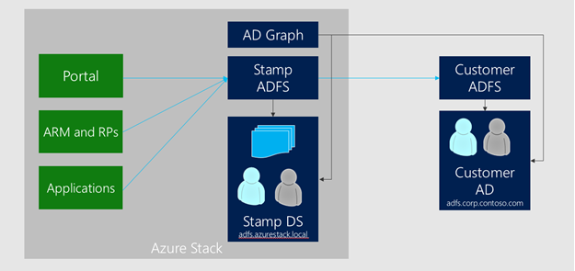
Active Directory Federation Services and Graph
Deploying with AD FS allows identities in an existing Active Directory forest to authenticate with resources in Azure Stack
This existing Active Directory forest requires a deployment of AD FS to allow the creation of an AD FS federation trust

Slide 38
Setting up AD FS integration
There are two ways to setup AD FS integration:
Setting up AD FS integration by downloading federation metadata https://docs.microsoft.com/en-us/azure/azure-stack/azure-stack-integrate-identity#setting-up-ad-fs-integration-by-downloading-federation-metadata
Setting up AD FS integration by providing federation metadata file https://docs.microsoft.com/en-us/azure/azure-stack/azure-stack-integrate-identity#setting-up-ad-fs-integration-by-providing-federation-metadata-file
Use b) if either of the following conditions are true:
The certificate chain is different for AD FS compared to all other endpoints in Azure Stack
There’s no network connectivity to the existing AD FS server from Azure Stack’s AD FS instance
At the existing AD FS, a relying party trust must be configured. This step is not done by the automation, and must be configured by the operator:
Configure relying party on existing AD FS deployment https://docs.microsoft.com/en-us/azure/azure-stack/azure-stack-integrate-identity#configure-relying-party-on-existing-ad-fs-deployment-account-sts

Slide 39

What is Graph?
Authentication (via AD FS) is one part of identity
To manage Role Based Access Control (RBAC) in Azure Stack, the Graph component must be configured
Graph
When access to a resource is delegated, the Graph component looks up the user account in the existing AD forest using the LDAP protocol
Graph only supports integration with a single AD forest. If multiple forests exist, only the forest specified in the configuration will be used to fetch users and groups

Slide 40
Requirements and Tasks
AD FS
At the existing AD FS, a relying party trust must be configured. This step is not done by the automation, and must be configured by the operator
Graph
For the Graph configuration, a service account must be provided that has Read permission in the existing Active Directory. This account is required as input for the automation to enable RBAC scenarios
Component | Requirement
Graph | Microsoft Active Directory 2012/2012 R2/2016
AD FS | Windows Server 2012/2012 R2/2016

Slide 41

Graph Ports
Graph service in Azure Stack uses the following protocols and ports to communicate with the target Active Directory:
Type | Network | Port | Protocol
LDAP | Public VIP | 389 | TCP & UDP
LDAP SSL | Public VIP | 636 | TCP
LDAP GC | Public VIP | 3268 | TCP
LDAP GC SSL | Public VIP | 3269 | TCP
This Photo by Unknown Author is licensed under CC BY-SA

Slide 42

ADFS and Smartcard Logon
In some environments, users may require smartcard logon (like US Federal PIV cards)
Connections using Windows Integrated Authentication will prompt for alternate authentication forms, including smartcard
The authentication request will go through AD FS to the associated Active Directory
This means that AD FS must be configured to include certificate authentication in the global authentication policy
If you need to authenticate with smartcard when running PowerShell scripts, you may also need to use this technique to enable it - https://github.com/Azure/azure-powershell/issues/9301
Notes:
ADFS configuration for smartcards detail is here - https://docs.microsoft.com/en-us/windows-server/identity/ad-fs/operations/configure-authentication-policies

Slide 43
Disconnected Time Sync
To NTP, or not to NTP

Slide 44

Time Sync
At a minimum, you should configure to sync time to the Active Directory instance that is connected using ADFS
If there is another NTP service in the environment that is Internet-connected, then you can use that as the time source for Azure Stack (and the connected Active Directory too)

Slide 45
Disconnected Marketplace Syndication
Keeping the marketplace fresh while offline

Slide 46
Disconnected Marketplace Syndication
How to download marketplace items?
Use PowerShell and the marketplace syndication tool to download the marketplace items to a machine with internet connectivity
You then transfer the items to your Azure Stack environment.
In a disconnected environment, you cannot download marketplace items by using the Azure Stack portal
https://docs.microsoft.com/en-us/azure/azure-stack/azure-stack-download-azure-marketplace-item

Slide 47
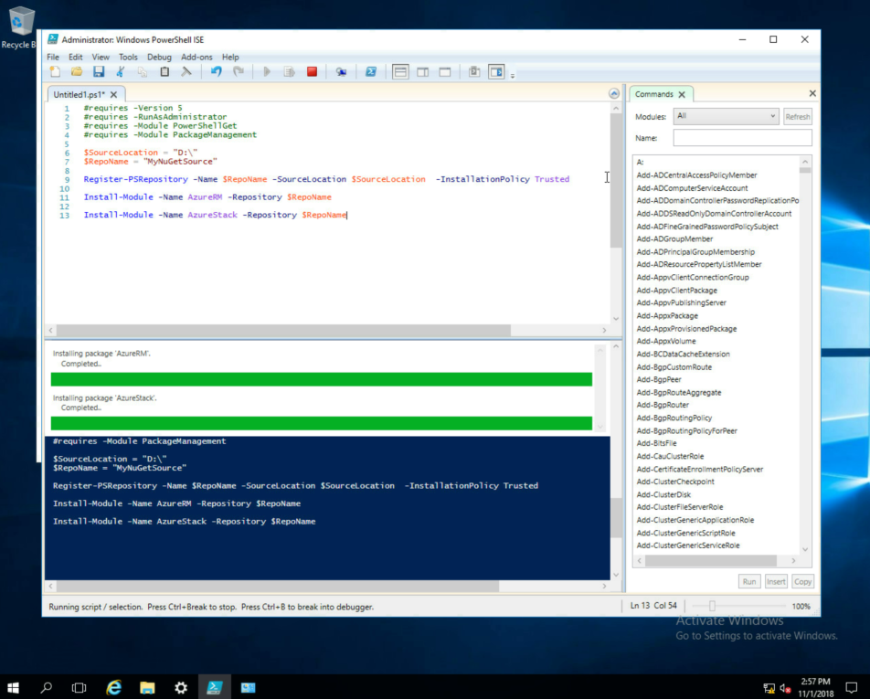
Prerequisites
Registered with Azure
Imported Azure Stack PowerShell Module
Imported PowerShell environment for the Azure Stack operator
Imported AzureStack-tools-master

Slide 48
Download Process
Add-AzureRmAccount (use the account that you used to register Azure Stack)
Get the tool ZIP file: [Net.ServicePointManager]::SecurityProtocol = [Net.SecurityProtocolType]::Tls12 invoke-webrequest https://github.com/Azure/AzureStack-Tools/archive/master.zip -OutFile master.zip
Unzip it, then load the tool: Import-Module .\Syndication\AzureStack.MarketplaceSyndication.psm1
Export-AzSOfflineMarketplaceItem -Destination "Destination folder path in quotes"

Slide 49
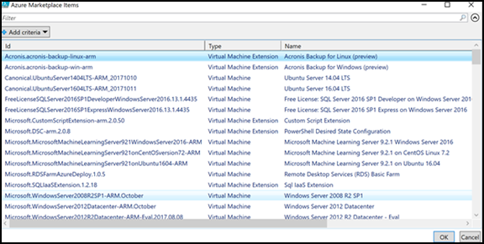
Selecting Marketplace items
Download VHD (VM images), ZIP (image extensions) or AZPKG (gallery package zip file)
NOTE: If you are refreshing the same marketplace items every month, you could use a variation of this script to select just the desired items…

Slide 50
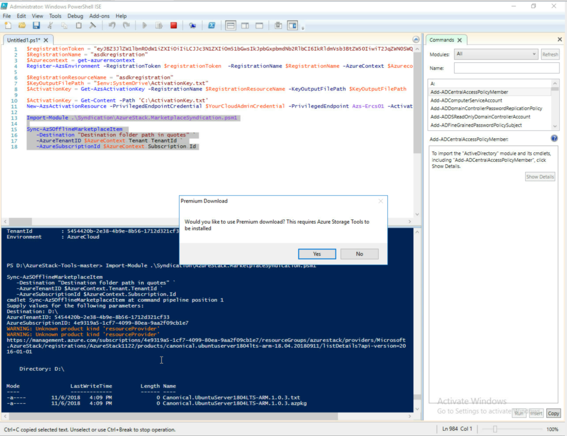
Copying to Azure Stack storage
If you have not installed Azure Storage Tools you will get a pop-up
In order to install these tools, make sure you download AzCopy

Slide 51
Import to Azure Stack Marketplace
Prepare and run the marketplace syndication tool in your disconnected Azure Stack environment. Refer to the downloaded content using the marketplace content folder file system path shown in the command below:
$credential = Get-Credential -Message "Enter the azure stack operator credential:“
Import-AzSOfflineMarketplaceItem -origin "marketplace content folder" -AzsCredential $credential

Slide 52
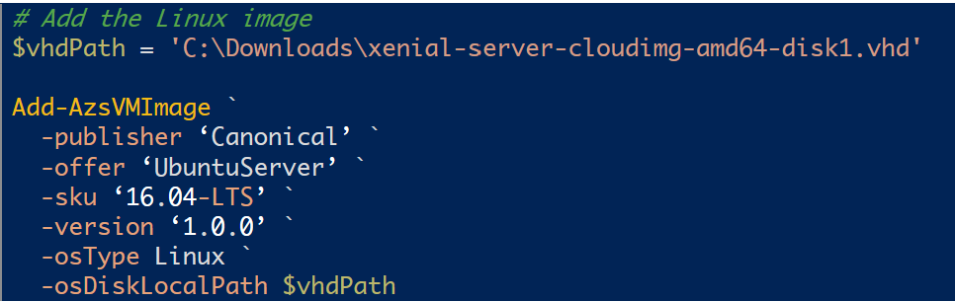
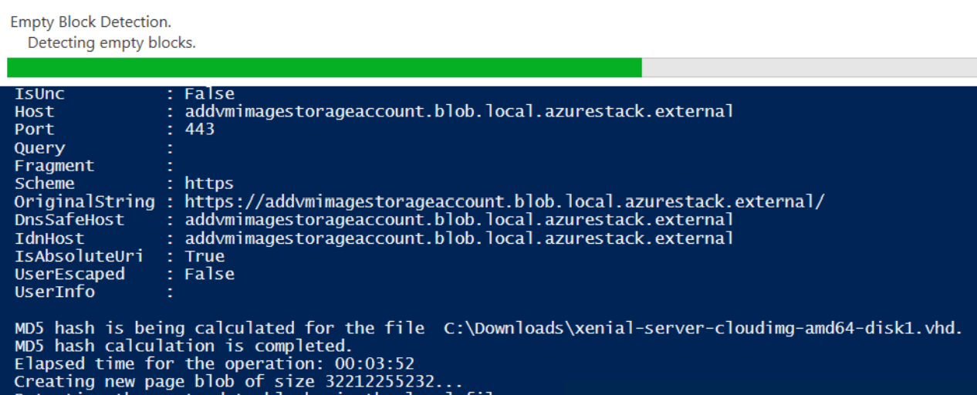
What about ‘side loading’?
Get VM image VHD file
Must be generalized (Windows sysprepped or Linux Azure VM with waagent deprovisioned)
Copy to blob storage on Azure Stack - note the blob location
Add it as a VM image using PowerShell, pointing to its blob location

Slide 53
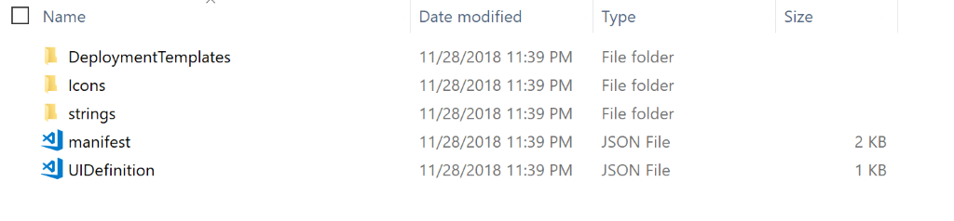
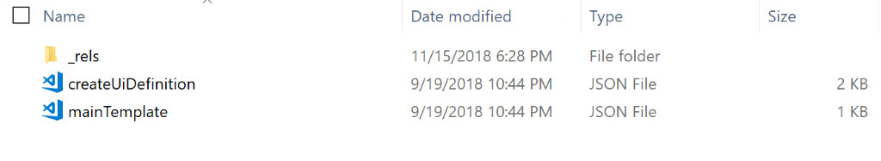
Side loading AZPKG
Can also side load a custom gallery item
Single virtual machine
Multiple Virtual Machines (Solution Template)
Virtual machine extension
AZPKG has a specific file/folder structure

Slide 54
Import an AZPKG
Add the context:
$ArmEndpoint = "https://adminmanagement.local.azurestack.external"
Add-AzureRMEnvironment -Name "AzureStackAdmin" -ArmEndpoint $ArmEndpoint
Add-AzureRmAccount -EnvironmentName "AzureStackAdmin"
Import the AZPKG, pointing to the AZPKG in blob storage:
Add-AzsGalleryItem –GalleryItemUri https://sample.blob.core.windows.net/gallerypackages/*offer.publisher.version*.azpkg –Verbose

Slide 55
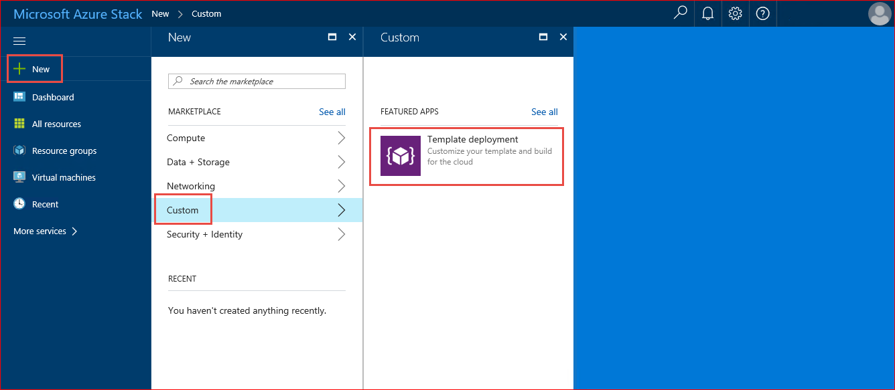
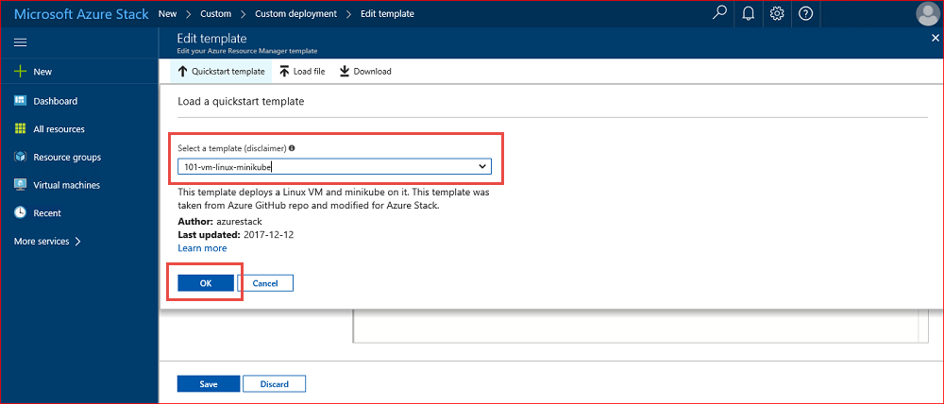
No Git Integration from Portal
In a connected Azure Stack, you can connect to Git from the portal to create resources using a custom ARM template from the community templates stored there
In disconnected Azure Stack, you will have to copy the ARM template from Git into Azure Stack as a side load
Notes:
See https://docs.microsoft.com/en-us/azure-stack/user/azure-stack-create-vm-template for the normal steps when you are connected.

Slide 56
Disconnected Licensing, Billing, and Consumption Reporting

Slide 57
Considerations
You must use capacity-based billing if you have no connectivity to public Azure
You can switch between capacity and consumption billing (if you later get connected), but you must pay out the current capacity period when you switch to the consumption model
In capacity-based billing, there are separate monthly bill rates for ‘just IaaS’ vs ‘IaaS and PaaS services’
You can capture actual consumption using the meters emitted directly from Azure Stack (not from Azure Commerce) using the local usage APIs

Slide 58
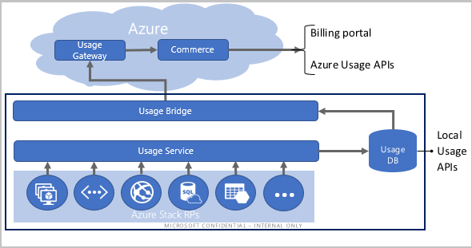

Connected vs disconnected billing and usage
Disconnected Azure Stack systems must use the capacity model for monthly billing
You can pull actual usage locally from Azure Stack’s meters
You Are Here

Slide 59
Disconnected Backup
Backing up the infrastructure or user workloads when disconnected or intermittently connected

Slide 60
Infrastructure Backup
Backup of disconnected Azure Stack Integrated system is the same as for connected Azure Stack Integrated System
Save the backups to a UNC path off-Stack. For example, use a file share on a server right next to the Azure Stack scale unit (could even be mounted in the same rack).
Border Router
Azure Stack

Slide 61
User workload Backup
Azure Site Recovery is not possible without an Internet connection
Agent-based backup software needs to be used
You cannot use Azure Backup Server, since it must be connected to Azure every 15 days, even if only performing local disk backups
Use backup solutions with an agent that runs inside the IaaS VMs

Slide 62

User IaaS VM backup/restore
Public Azure
Secure connections using S2S VPN and ExpressRoute
Azure Stack
Service Provider
Use existing products on-prem or remote
Tenant driven workflows
Existing backup tools can target several backup targets…
Azure Stack Customer
Application, file/folder, and page-blob snapshot level snapshot
Support for Microsoft and 3rd party products
Service Provider
Notes:
This is leveraging existing backup tools to perform the backup of IaaS VMs.
Azure Backup is currently supported, but not Data Protection Manager (DPM).
Note that ExpressRoute connections are from Azure Stack to a network edge device (over S2S VPN)
and then from the network edge to Azure datacenters using ExpressRoute.
(ExpressRoute doesn’t terminate right at the Azure Stack system)

Slide 63
Disconnected Support Scenarios
Troubleshooting a disconnected Stack

Slide 64
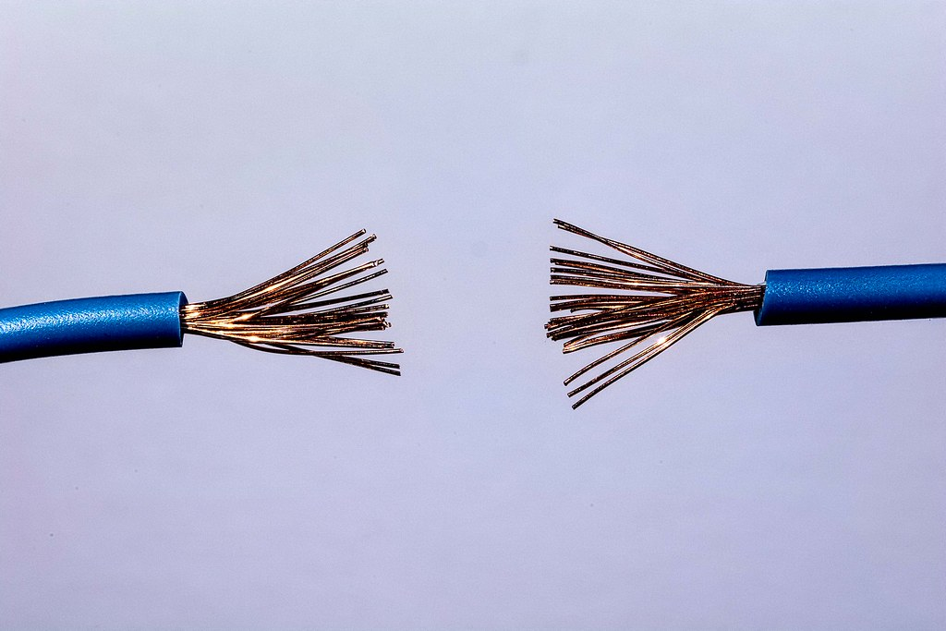
Support scenarios
Log collection
Will have to use a {copy, connect, then send} approach
Unlock token
The unlock token for the privileged endpoint is a really long string that you would normally cut and paste
Working with support
Difficult with no screen sharing

Slide 65
Windows Activation for User VMs
How it works…

Slide 66
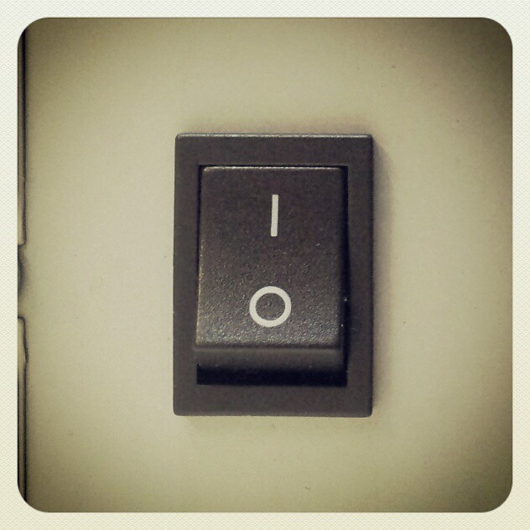
In Azure…
KMS activation
In Azure Stack…
Automatic VM activation (AVMA)
AVMA does not work for guests prior to Windows Server 2012 R2
Could still implement your own KMS or volume activation solution as long as it resides in the disconnected environment too
If the VM is not set up for AVMA, run slmgr /ipk <AVMA key> in the VM

Slide 67
‘Reconnecting’ an Azure Stack
Considerations

Slide 68
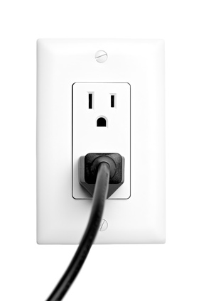
No ‘disconnected’ setting!
Azure Stack does not have a specific setting indicating it is disconnected
If you reconnect…
The public IP range cannot be changed, so it may not be correct for connecting above the ToR switches
Once reconnected, you could switch from capacity to consumption-based billing
You could enable Marketplace syndication
(You cannot change from AD FS to AAD authentication)

Slide 69
Questions?

